Slide 1



Research Project Management Principles & Tools (Juggling 101)
Notes:
http://meetings.esipfed.org/event/Eypx/research-project-management-principles-and-tools-aka-juggling-101-part-1

Slide 2

Karl Benedict, PhD
Ward Fleri, PhD, PMP
ESIP Summer Meeting
17 July 2018
Tucson, AZ

Slide 3
Overview
Session 1
Why us?
Why project management?
What is a project?
Requirements & scope
Intro to TaskJuggler
The triple constraint
Task breakdown
Estimating effort
Session 2
Assigning resources
Budgeting
Project execution
Communication
Analysis & visualization
Project close-out
Career implications

Slide 4
Who are we and why are we talking about this?
Ward Fleri
PhD in Applied Math from Brown University
Photon Research Associates – Scientist, PM, Software Engineering Group Leader
Protein Data Bank at UCSD/SDSC – PM
Immune Epitope Database at LJ Institute – PM
Project Management Professional since 2003
Certified Scrum Master since 2016

Slide 5
Who are we and why are we talking about this?
Karl Benedict
PhD in Anthropology from the University of New Mexico
Director of Research Data Services, UNM Libraries
Former Director and Research Scientist, Earth Data Analysis Center, UNM
Cyberinfrastructure Lead/ Co-I for multiple large-scale, multi-year NSF and NASA funded projects

Slide 6

Why Knowing Project Management Makes Sense No Matter What Career You Choose

Slide 7



Importance of Project Management
You are already involved in projects
Writing proposals
Organizing awards
Communicating among team members, subcontractors, your boss
Achieving results on time and within budget
Developing leadership skills

Slide 8
Top 10 Skills Employers Seek in 20-Something Employees
Ability to:
Work in a Team
Make Decisions & Solve Problems
Plan, Organize & Prioritize Work
Communicate Verbally
Obtain & Process Information
Forbes
October 2013

Slide 9

Analyze Quantitative Data
Technical Knowledge in Job
Proficiency with Computer Software
Create/Edit Written Reports
Sell & Influence Others
Forbes
October 2013

Slide 10

The Top 12 Skills Employers Seek
1. Positive Attitude
2. Strong Work Ethic
3. Excellent
Communication
4. Problem-Solving
5. Time Management
6. Flexibility
The Balance
Dec 2017

Slide 11

7. Work in Team Environment
8. Computer/Technology
9. Project Management
10. Self Confidence
11. Accept Constructive Criticism
12. Strong Research Skills

Slide 12
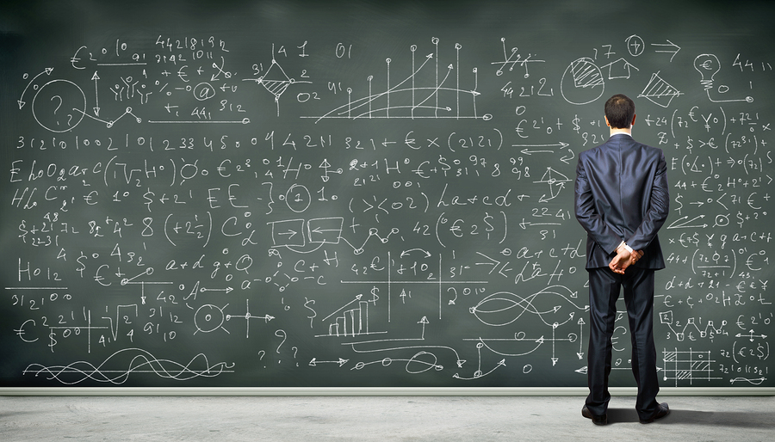
What should you know?

Slide 13

Individuals going about the daily routine of their job will need to know how to prioritize and plan each activity to be able to get the best job done in the least amount of time.

Slide 14



What is a project?
A temporary effort with a beginning and an end.
It creates a unique product, service, or result.

Slide 15

Some basic
project management concepts

Slide 16

Requirements & Scope
Know Where You’re Going
Goals, aims, objectives
Pick a Road
Approaches, constraints, assumptions

Slide 17
Out of Scope
In Scope
Aim 1
Aim 2
Aim 3
Feature 1
Feature 2
Feature 3
Feature 4
Related Aims
Related Goals
Additional New Features

Slide 18

Beware of Scope Creep!

Slide 19
Introduction to TaskJuggler
Overview
Project skeleton

Slide 20
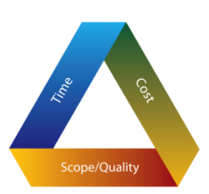
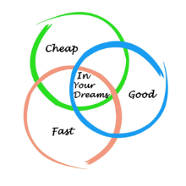
The Triple Constraint (Iron Triangle)
Prioritize Pick 2

Slide 21




Constraint Prioritization → Communicate with Stakeholders
The Boss
Team Members
End Users
Sponsors

Slide 22

Planning
Break down the overall effort into manageable tasks.

Slide 23
TaskJuggler
Project outline

Slide 24

Identify dependencies among tasks.

Slide 25

Estimate duration of tasks.

Slide 26
TaskJuggler
Progressive elaboration

Slide 27
Session 2

Slide 28

Assign Resources (People & Equipment)

Slide 29

Make a Budget

Slide 30
TaskJuggler
Assigning resources
Cost estimation

Slide 31

Expect Changes

Slide 32
Plan with a Gantt Chart
Microsoft Project ($600)
TaskJuggler (Free)

Slide 33
Some Programs Offer Resource Profiling

Slide 34
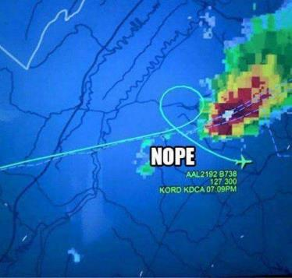
Project Execution
Identify risks
Expect variations from the plan
Correct course as needed
Provide leadership to the team

Slide 35
TaskJuggler
Project tracking

Slide 36

Surprises are usually not good

Slide 37

Communication
Did you know?
The majority of communication is nonverbal.

Slide 38
Good communication is critical.

Slide 39

Choose the most effective means for the situation
Email Phone Face-to-Face Formal Reports

Slide 40

Communication Channels Expand Quickly
N (N-1) /2
N = # of Stakeholders

Slide 41
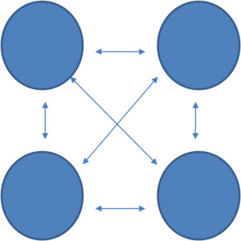
4 Stakeholders?
4 (4-1) /2 = 6

Slide 42

10 Stakeholders?
10 (10-1) /2 = 45

Slide 43
TaskJuggler
Visualization
Reporting

Slide 44
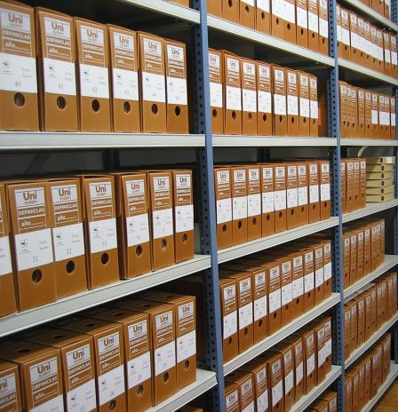
Project Closeout
Make final contractual deliverables (e.g. code, reports)
Finalize financials (vendors, subcontractors, invoices)
Archive all artifacts
Meet with team for “Lessons Learned”

Slide 45

Learn from Your Successes and Failures
If you want to succeed, double your failure rate.
Thomas Watson

Slide 46

Career Implications
More effective use of time & resources
Opportunity to develop leadership & management skills
Critical skills to have as a PI

Slide 47

Alternative career path to traditional PI research trajectory
Sought-after skills in science, engineering, and software organizations
Expanded domain flexibility

Slide 48


